Slide 1
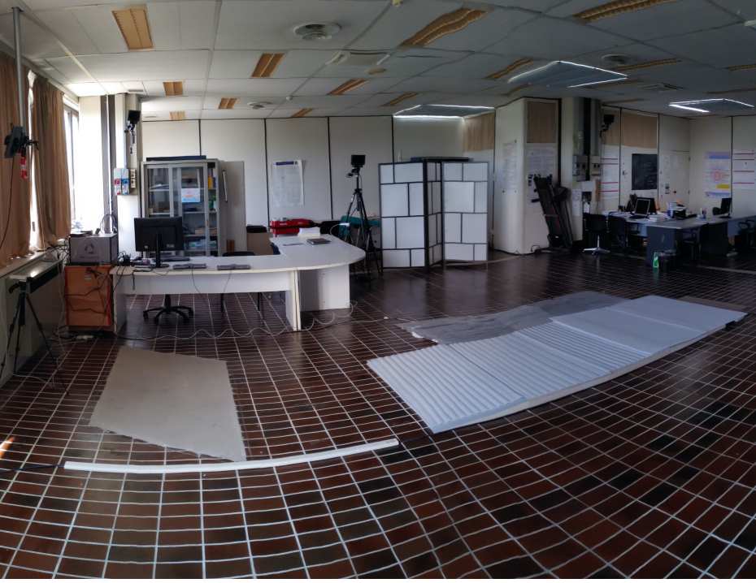

Balance and posture
Kalman filters
Electromyographic analysis
Hadi Kabri
Abd alrahman alhindi
Master’s Degree
In Biomedical Engineering
a.A 2024/2025

Slide 2
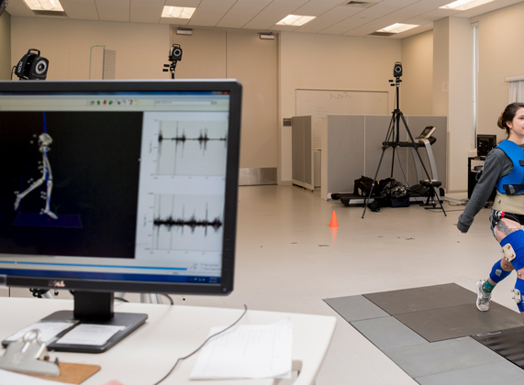
Introduction
Bioengineering of motor rehabilitation is the application of bioengineering methods and techniques for the functional evaluation of motor functions in people with disabilities. Functional evaluation’s aim is the development of tools and methodologies for the analysis of movement based on quantitative criteria, that are objective and repeatable.
The aim of this project is to evaluate motor ability of healthy subjects while performing motor tasks. In particular :
The study of human balance during static posturography;
The evaluation of human locomotion;
The post processing application of Kalman filtering and smoothing;
The muscles activations and deactivations analysis during gait cycle.
The data were collected during laboratory experiences at the “Analysis of Movement Laboratory” of Università Politecnica delle Marche.

Slide 3
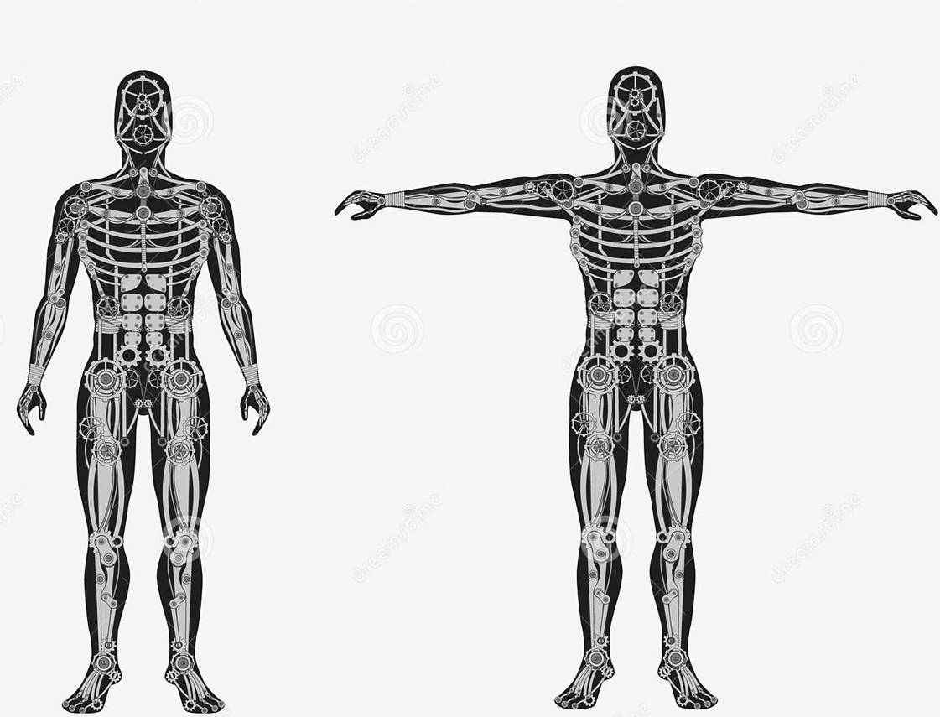
Human Balance
and Posture Control Analysis

Slide 4
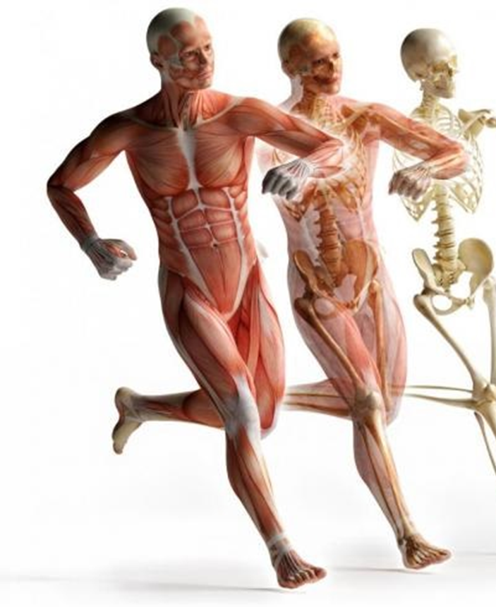
Human Balance and Posture Control Analysis - Introduction
The human balance and the posture system in the field of Bioengineering Rehabilitation are considered as pillars.
Posture: describes the orientation of any body’s segment, relative to the gravitational vector.
Balance: generic term that describe the dynamics of body posture to prevent falling. It is related to the inertial forces acting on the body and the inertial characteristics of body segments.
Sway: it is the oscillation (angle) of the body with respect to the vertical direction.

Slide 5
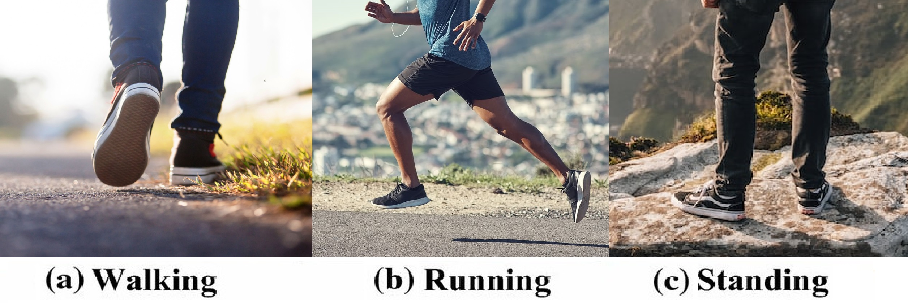
Human Balance and Posture Control Analysis - Introduction
The major challenge to the human balance control system is related to the fact that humans are bipeds and locomote over the ground with one foot in contact (a), no feet in contact (b), or both feet in contact (c). Thus, because two-thirds of the body mass is located two-thirds of the body height above the ground, humans are an unstable system unless a control system is continuously acting.

Slide 6
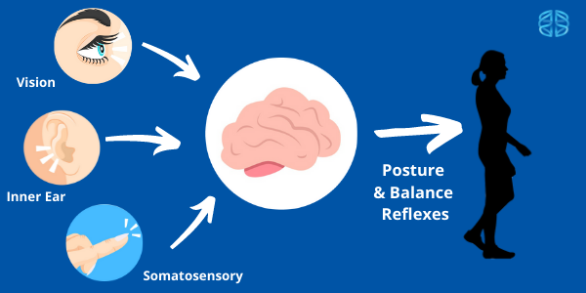
Human Balance and Posture Control Analysis - Introduction
Maintaining balance requires coordination of inputs from multiple sensory systems including: ​
Visual system: which detects and interprets information from visible light to build a representation of the surrounding environment where plan locomotion and avoid obstacles.
Vestibular system (inner ear): which provides the leading contribution to the sense of balance, spatial orientation and coordination, mainly because it senses linear and angular accelerations.
Somatosensory system: that collects information from skin, joints and the rest of the body, as it senses position and velocity of all body segments, their contact with external environment and the orientation of gravity.​

Slide 7
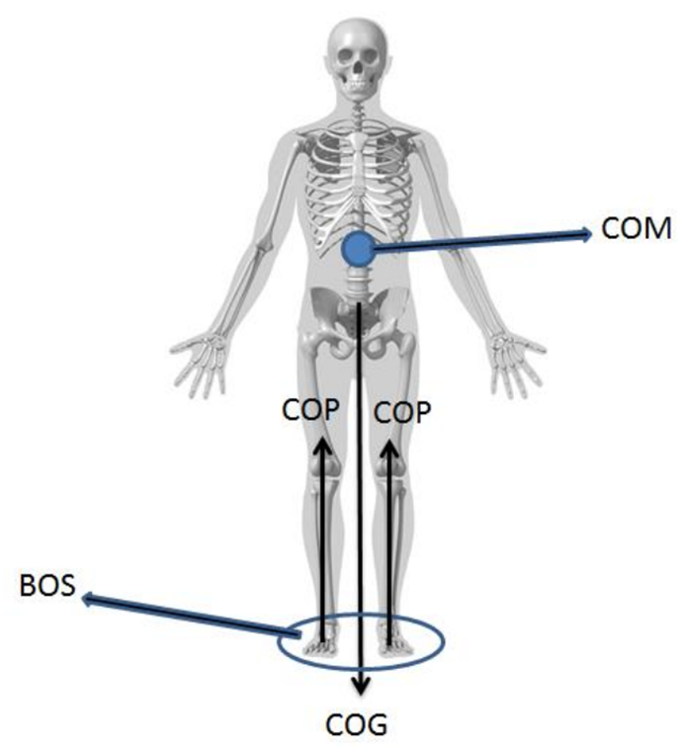
COP & COM
The main two elements that explain human balance and posture control during standing and walking are: the Center of Mass (COM) and the Center of Pressure (COP). ​
According to D. A. Winter (1995), COM is a point equivalent of the total body mass in the global reference system and is the weighted average of the COM of each body segment in 3D space. It is a passive variable controlled by the balance control system and the vertical projection of the COM onto the ground is often called the Center of Gravity (COG). ​
COP is the point location of the vertical ground direction force vector on the surface of a force platform, and it represents a weighted average of all the pressures over the surface of the area in contact with the ground.

Slide 9
Results - Time-Domain "Distance" Measures:
Measures | Eyes opened | Eyes closed | Romberg Ratio | Interpretation
Mean radial Distance ( MDIST) | 1.556389 | 1.909782 | 1.22706 | Sway increased with eyes closed, showing reduced postural stability.
Mean AP Distance(MDIST-AP) | 1.228287 | 1.652699 | 1.345531 | Greater forward-backward sway in the absence of visual cues
Mean ML Distance(MDIST-ML) | 0.664668 | 0.735108 | 1.105977 | Slight increase in lateral sway, but less than AP.
RMS Radial Distance(RDIST) | 1.791629 | 2.369409 | 1.322489 | Variability in sway amplitude increased without vision.
RMS AP Distance(RDIST-AP) | 1.573444 | 2.190918 | 1.392434 | RMS sway in AP direction increased significantly.
RMS ML Distance(RDIST-ML) | 0.856858 | 0.902206 | 1.052923 | Mild increase in RMS sway in ML direction
Total Excursion(TOTEX) | 65.062822 | 140.748382 | 2.163269 | Total length of sway path more than doubled with eyes closed
Total AP Excursion(TOTEX-AP) | 53.905978 | 131.453184 | 2.438564 | Most of the increase came from AP movement.
Total ML Excursion(TOTEX-ML) | 26.533738 | 33.717881 | 1.270755 | Moderate increase in ML path length.
Max point distance(d-PD) | 8.249263 | 14.339401 | 1.738265 | Maximum distance between any two points increased, reflecting instability.
AP Range(d-AP) | 8.007206 | 13.982865 | 1.746285 | Range of movement in AP widened significantly.
ML range(d-ML) | 4.034683 | 3.781705 | 0.937299 | Small decrease in ML range; less contribution to instability.
Mean velocity(MVELO) | 3.253141 | 7.037419 | 2.163269 | COP moved over twice as fast with eyes closed.
Mean AP velocity(MVELO-AP) | 2.695299 | 6.572659 | 2.438564 | AP velocity showed major rise—key sign of instability.
Mean ML velocity(MVELO-ML) | 1.326687 | 1.685849 | 1.270755 | Smaller but still increased lateral motion velocity.

Slide 10
Time-Domain Distance Measures - Comment :
These parameters clearly show a considerable increase in sway and instability when visual feedback is removed (eyes closed). Most notably:
Total excursion (TOTEX), mean velocity (MVELO), and range measures increased significantly, especially in the antero-posterior (AP) direction.
The Romberg ratios for almost all metrics are > 1, confirming that the absence of vision leads to compensatory increases in body movement to maintain balance.
The ML values, while increased in some measures, are consistently less affected than AP, suggesting that vision plays a stronger role in stabilizing front-back balance than side-to-side.
Another comment :
The time-domain distance measures reveal that the subject exhibited greater postural sway and instability during the eyes-closed condition. Key parameters such as mean distance, RMS values, total excursion, and sway velocity all increased significantly, especially in the anterior-posterior direction. The Romberg ratios consistently exceeded 1 for most AP-related metrics, confirming that visual input plays a critical role in stabilizing AP movements. Medio-lateral control was less affected, suggesting a stronger reliance on proprioceptive and vestibular systems in that plane. Overall, these findings support the importance of visual cues in maintaining static postural balance.
Final comment:
The analysis of Time-Domain “Distance” parameters demonstrates a clear deterioration in postural control when visual input is removed. All key metrics—such as mean distance, RMS distance, total excursion, and mean velocity—increased under eyes-closed conditions, indicating that the subject exhibited greater postural sway and less stability.
The antero-posterior (AP) direction showed the most pronounced changes, as seen in parameters like TOTEX_AP, d_AP, and MVELO_AP, emphasizing the visual system’s crucial role in maintaining balance in the front-back direction.
On the other hand, changes in medio-lateral (ML) measures were less pronounced, with some metrics showing only minimal differences or even slight decreases, suggesting lateral stability is less visually dependent in quiet stance.
The consistent Romberg ratios > 1 across most distance measures reinforce the finding that visual feedback significantly contributes to minimizing body sway and maintaining upright posture, particularly in the forward-backward plane.

Slide 11
Results - Time-Domain "Area" Measures :
Measures | Eyes opened | Eyes closed | Romberg ratio | Interpretation
95% Confidence Circle Area (AREA_CC) | 28.58 | 55.86 | 1.954 | The sway area nearly doubles with eyes closed, indicating greater postural instability.
95% Confidence Ellipse Area (AREA_CE) | 25.39 | 36.11 | 1.42 | The increase confirms more dispersed sway paths when vision is removed.
Results -Time-Domain "Hybrid" Measures:
Measures | Eyes Opened | Eyes closed | Romberg Ratio | Interpretation
Sway Area (AREA_SW) | 1.31 | 2.76 | 2.10 | Sway area nearly doubles, indicating greater instability with eyes closed.
Mean Frequency (MFREQ) | 0.33 | 0.58 | 1.76 | Oscillations are faster without vision, reflecting more frequent corrections.
Mean AP Frequency (MFREQ_AP) | 0.38 | 0.70 | 1.81 | AP-specific correction rate increases with visual deprivation.
Mean ML Frequency (MFREQ_ML) | 0.35 | 0.40 | 1.14 | Moderate increase, suggesting more sway in the ML direction as well.
Fractal Dimension (PD) | 1.37 | 1.42 | 1.04 | Slight increase in sway path complexity based on max distance.
Fractal Dimension (CC) | 1.45 | 1.58 | 1.09 | Higher spatial complexity of sway within the 95% circle.
Fractal Dimension (CE) | 1.39 | 1.51 | 1.08 | Similar to CC, more complex sway pattern within the 95% ellipse.

Slide 12
The Time-Domain "Area" and "Hybrid" Measures together provide valuable insight into postural control stability and complexity.
The Area measures (95% Confidence Circle and Ellipse) clearly show that the spatial dispersion of the COP path significantly increases when the eyes are closed. This indicates that the body sways over a broader region in the absence of visual feedback, pointing to reduced spatial control and greater reliance on proprioceptive and vestibular systems.
The Hybrid measures add dynamic and structural information. The sway area (AREA_SW) and mean frequencies (MFREQ, MFREQ_AP, MFREQ_ML) are all higher during eyes-closed trials, reflecting more frequent and irregular corrective postural movements. The increased fractal dimensions (FD_PD, FD_CC, FD_CE) further indicate that the sway patterns become more complex and less predictable, highlighting a loss of fine motor control in balance regulation.

Slide 13
Results - Frequency-Domain Measures
Total Power Values - represent the energy (variance) in the COP signal in each direction.
Measures | Eyes opened | Eyes closed | Romberg ratio | Interpretation
Total RD Power (u0_RD) | 7775.23 | 10806.48 | 1.39 | Energy increases → more overall instability.
Total AP Power (u0_AP) | 6163.50 | 9630.02 | 1.56 | Clear postural instability in the AP direction with eyes closed.
Total ML Power (u0_ML) | 1735.59 | 1644.20 | 0.95 | Slightly lower → lateral sway less affected by vision.
95th Percentile Frequency Values - show the frequency below which 50% of the signal’s power is contained.
Measures | Eyes opened | Eyes closed | Romberg ratio | Interpretation
f_05_RD | 0.1207 | 0.1210 | 1.00 | Almost no change – consistent power distribution.
f_05_AP | 0.2223 | 0.3237 | 1.46 | Shift to higher frequency → more rapid postural corrections.
f_05_ML | 0.2113 | 0.2323 | 1.10 | Slight increase in lateral correction frequency.

Slide 14
95th Percentile Frequency Values - show the upper frequency threshold containing 95% of power.
Measures | Eyes opened | Eyes closed | Romberg ratio | Interpretation
f_095_RD | 0.55 | 1.29 | 2.33 | Much broader frequency range → more variability.
f_095_AP | 0.62 | 1.52 | 2.46 | Strong increase – greater neuromuscular activity in AP.
f_095_ML | 0.58 | 0.77 | 1.34 | Moderate increase – lateral corrections also broaden.
Centroidal Frequencies (CFREQ) Values - describe the "center of mass" of the frequency distribution
Measures | Eyes opened | Eyes closed | Romberg ratio | Interpretation
CFREQ_RD | 0.29 | 0.59 | 2.05 | Shift toward higher frequency – unstable system.
CFREQ_AP | 0.37 | 0.69 | 1.86 | Same AP dominance in frequency shift.
CFREQ_ML | 0.34 | 0.44 | 1.29 | Moderate rise – again, ML less affected.

Slide 15
Frequency Dispersion (FREQD) Values - reflects variability in the frequency content.
Measures | Eyes opened | Eyes closed | Romberg ratio | Interpretation
FREQD_RD | 0.78 | 0.86 | 1.09 | Slight increase – slightly more irregular.
FREQD_AP | 0.69 | 0.67 | 0.98 | Slight decrease – possibly more consistent corrections.
FREQD_ML | 0.67 | 0.73 | 1.09 | Slightly broader spread – more frequency variability.
Comment on Frequency-Domain Measures results:
The frequency-domain analysis reveals that removing visual input results in higher power, higher frequency, and broader frequency spread, especially in the antero-posterior direction. This reflects a postural system that responds more frequently and with higher intensity to maintain balance, due to increased instability and reduced sensory feedback. The elevated centroidal and 95th percentile frequencies show that balance control becomes more active and less efficient.

Slide 16
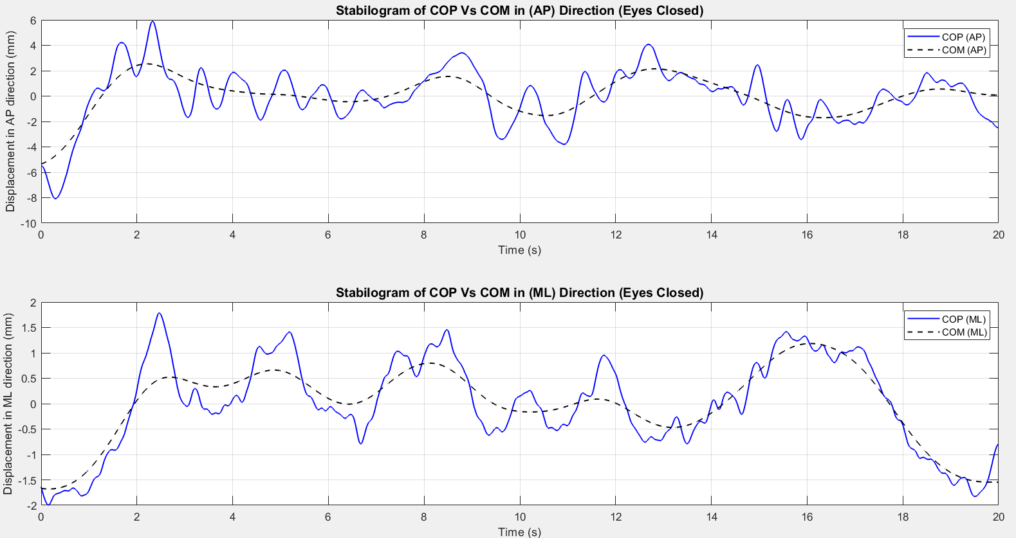
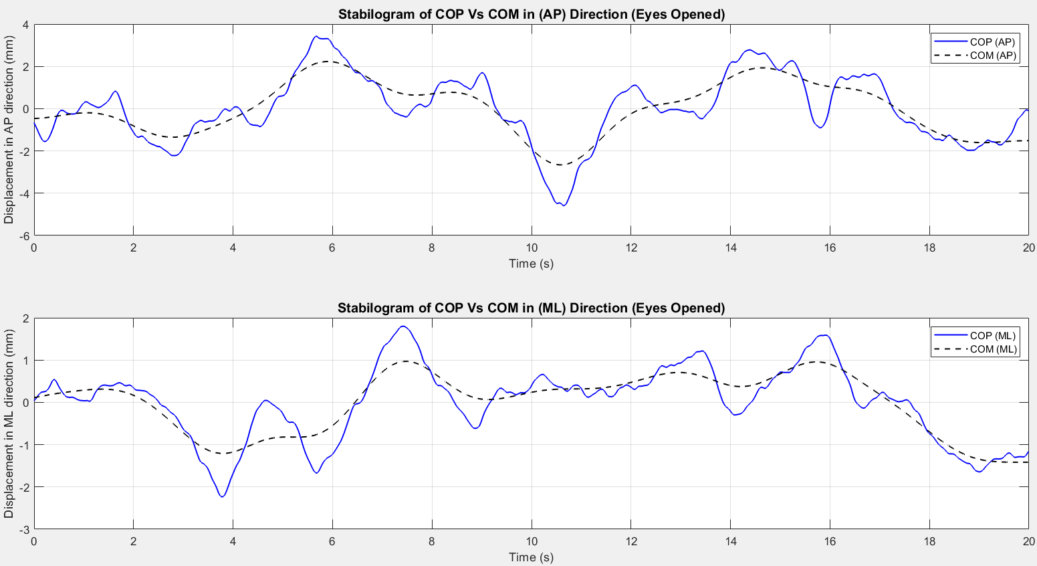
Figure 1-1 Figure 1-2
These stabilograms confirm that closing the eyes results in greater postural instability, as reflected by larger and less coordinated COP movements relative to COM. The COP-COM distance increases, particularly in the AP direction, highlighting the essential role of vision in postural control. Conversely, with eyes open, balance corrections are faster and more accurate, demonstrating a more stable stance.

Slide 17
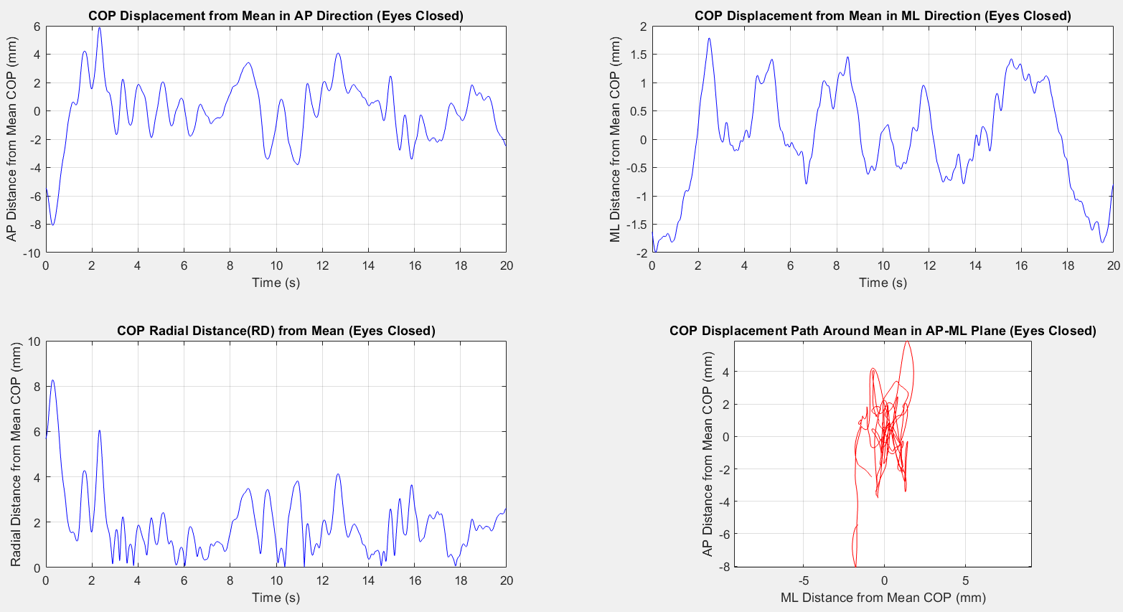
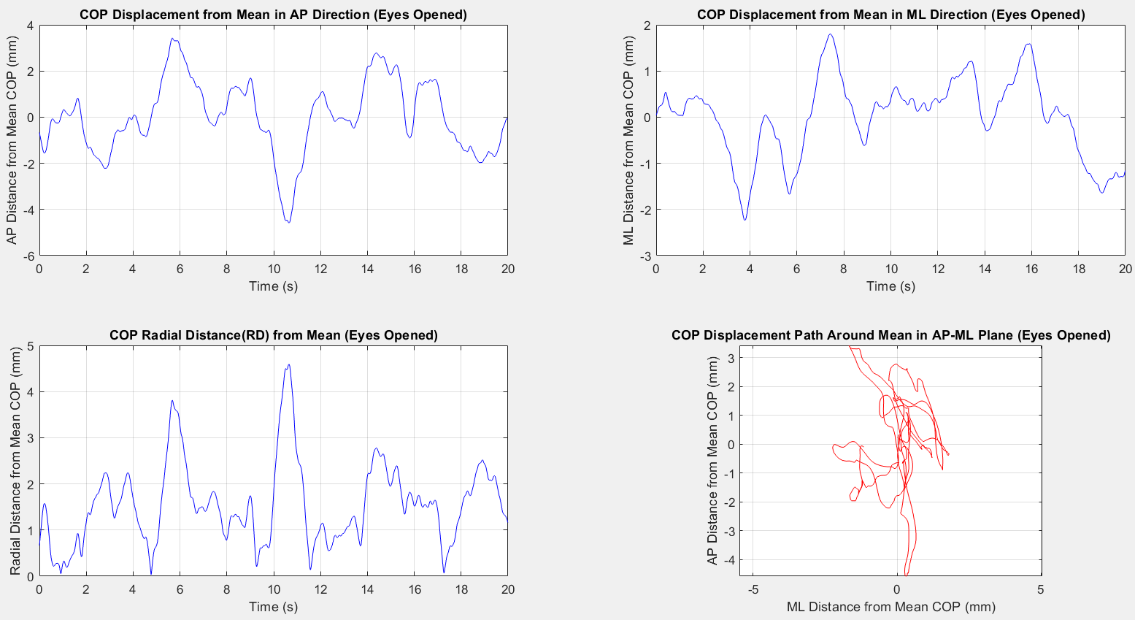
Figure 1-3 Figure1-4
This pair of plots clearly illustrates the destabilizing effect of visual deprivation.
With eyes open, the subject maintains tighter control, smaller sway, and a well-centered trajectory.
With eyes closed, sway increases significantly, especially in the AP direction, and the COP path becomes more erratic and wider.
These findings are consistent with Romberg ratio results and support the conclusion that visual input plays a crucial role in maintaining balance and minimizing postural sway.

Slide 18
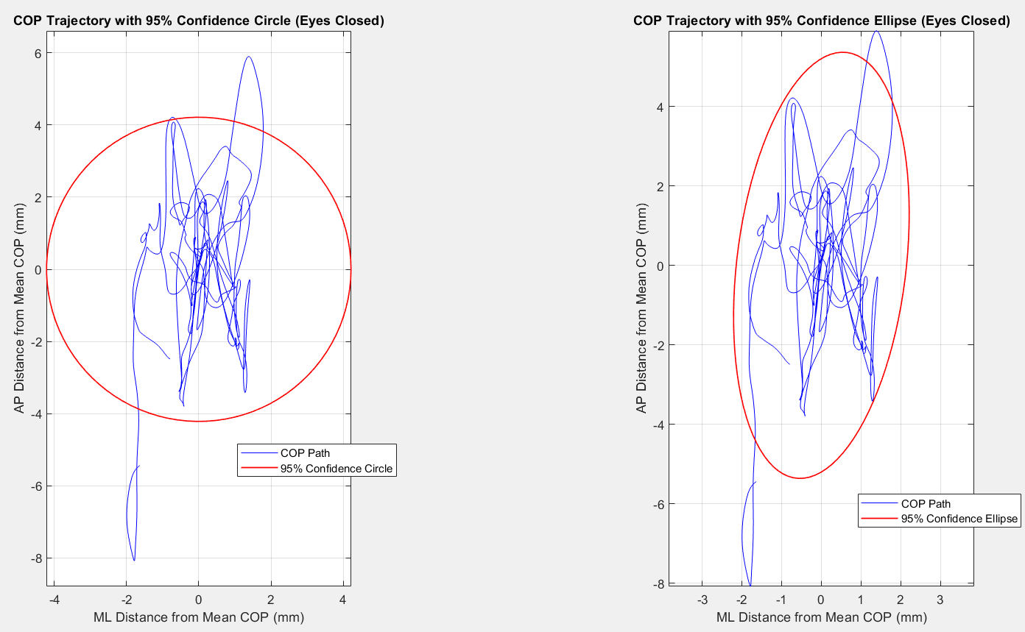
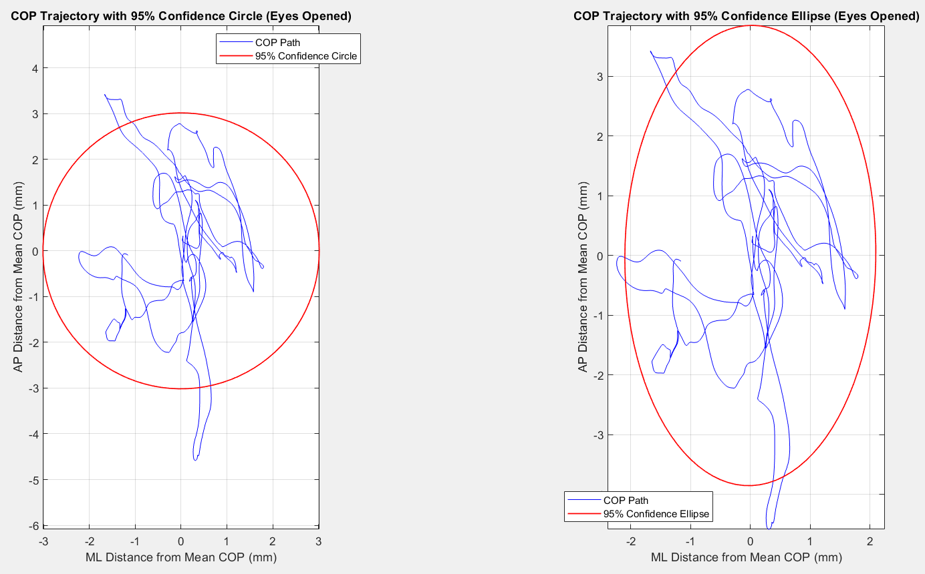
Figure 1-5 Figure1-6
These confidence plots provide a powerful visual confirmation of the numerical results:
Eyes open: Postural control is efficient and tightly regulated.
Eyes closed: The absence of visual input leads to increased sway, wider confidence areas, and directional instability.
In conclusion, these plots reinforce the critical role of visual feedback in maintaining balance, and show how confidence measures (circle and ellipse) can effectively capture and illustrate differences in postural sway patterns between conditions.

Slide 19
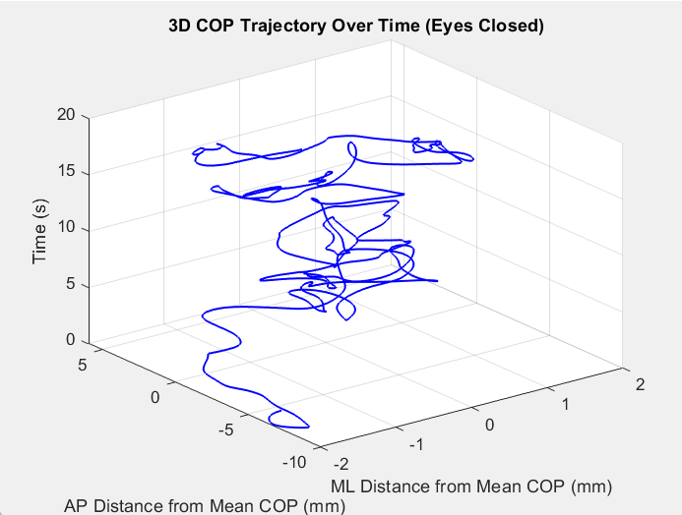
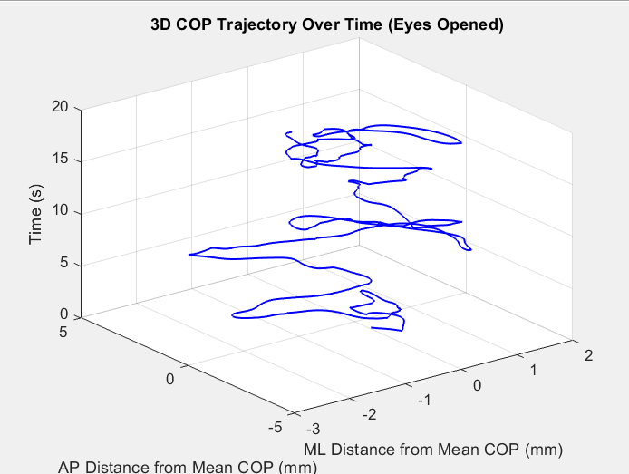
Figure 1-7 Figure1-8
The 3D trajectory plot vividly illustrates the impact of visual feedback on postural control. With eyes open, the COP path remains more centralized and less erratic over time. In contrast, when the eyes are closed, the COP exhibits greater spatial dispersion and irregular transitions, suggesting a compensatory reliance on proprioceptive mechanisms. The loss of vision clearly increases the complexity and instability of the balance response, reinforcing the importance of visual input in postural stability.

Slide 20
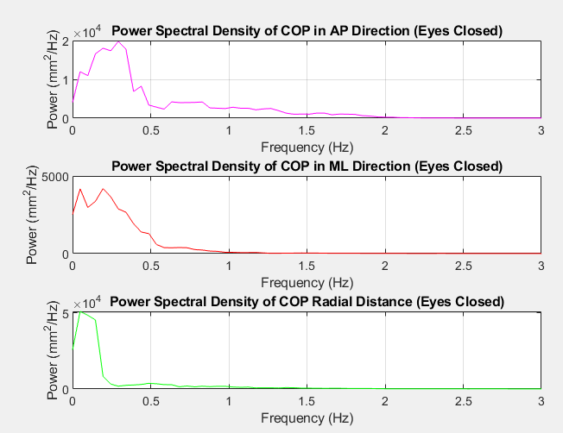
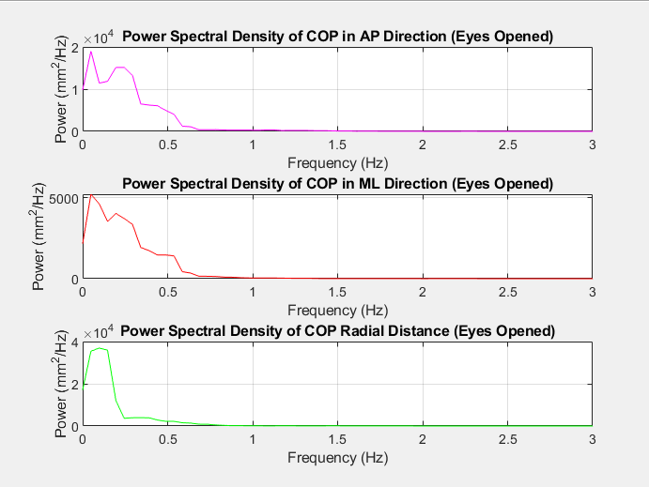
Figure 1-9 Figure1-10
These spectral plots quantitatively illustrate how visual input plays a vital role in maintaining postural control.
With eyes closed, power spectral energy increases across all directions (AP, ML, RD), and spreads into higher frequencies, confirming that sway becomes larger, faster, and less predictable. The subject exhibits increased postural instability, particularly in the AP direction, reflecting the shift in reliance from visual to proprioceptive and vestibular inputs. This outcome is consistent with Prieto's findings and complements the time-domain and area-domain measures.

Slide 21
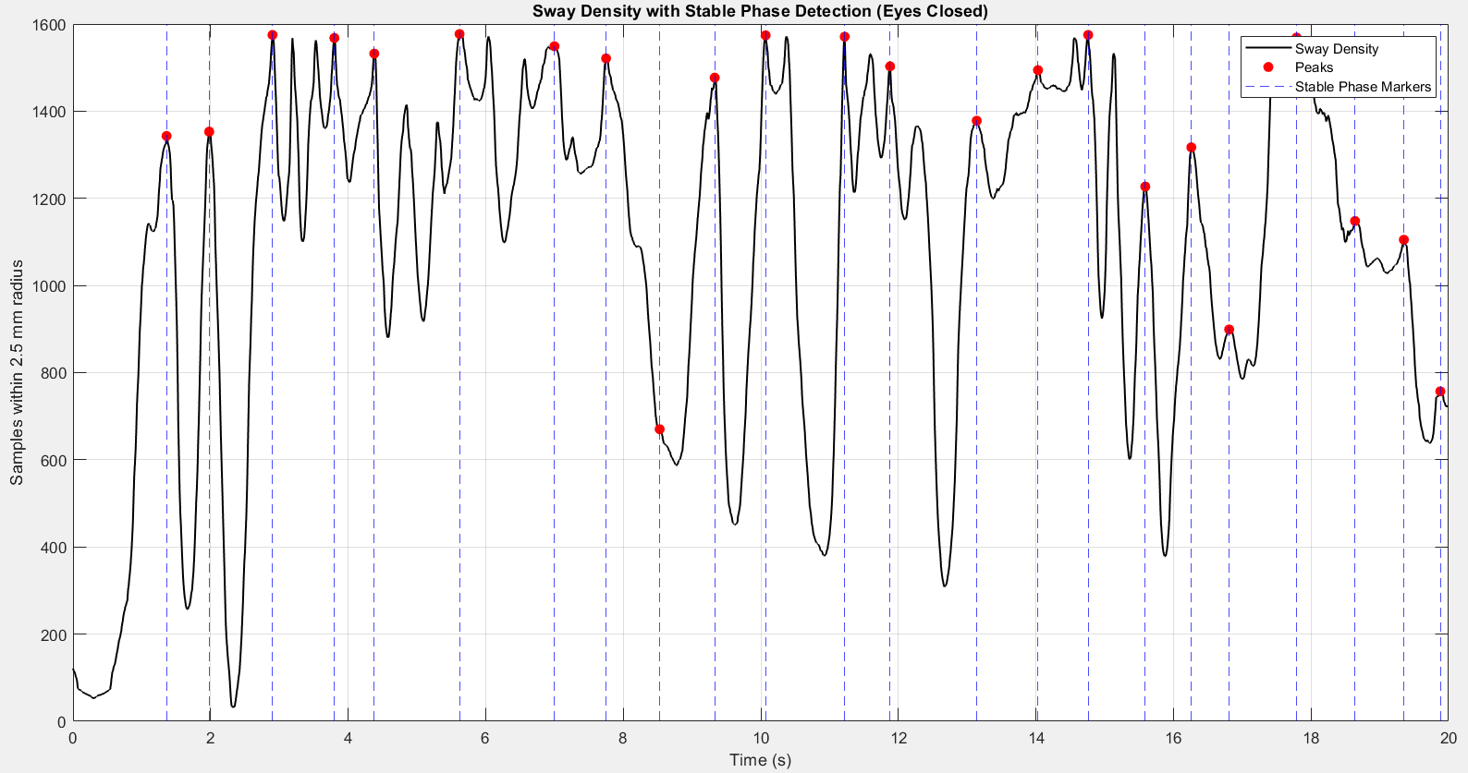
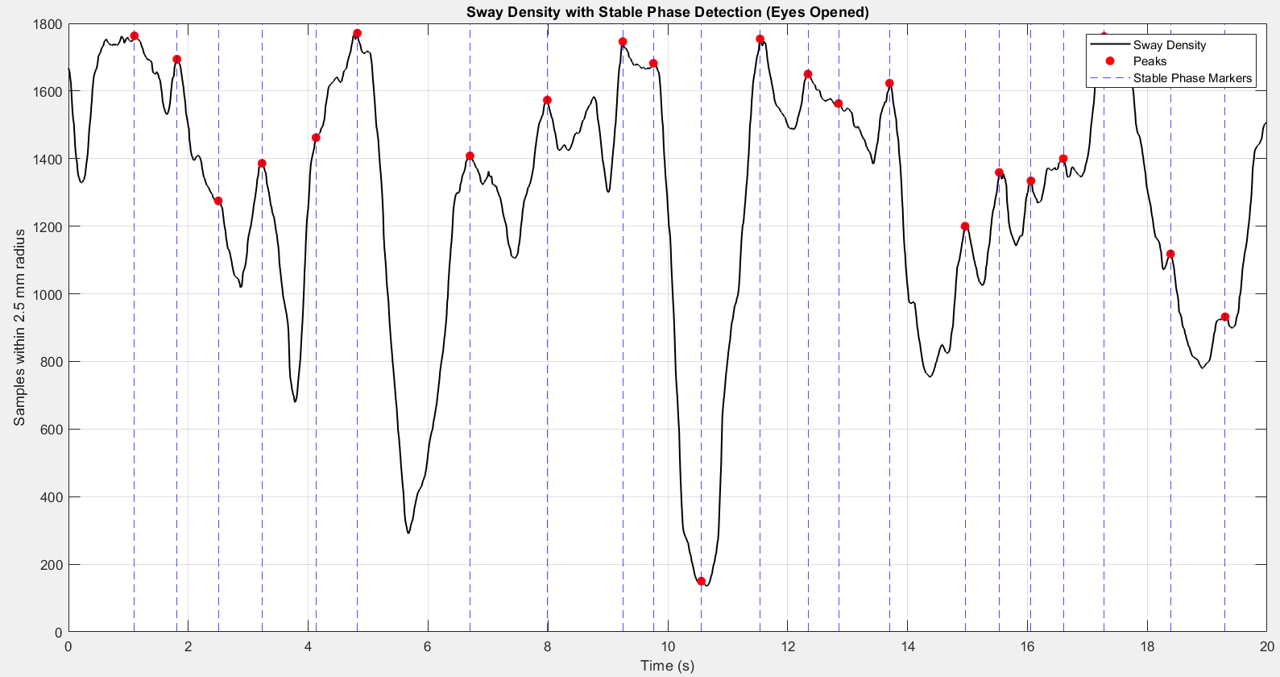
Figure 1-11 Figure1-12
When the subject kept their eyes open, the sway density curve had smooth peaks that were wide and spaced regularly. This means the person was able to keep their balance steady for longer times, with less need for quick corrections. The stable phases were clear and lasted longer, showing strong postural control.
But with eyes closed, the curve became noisy and irregular, with many sharp and short peaks. This means the person was less stable, and their balance kept changing quickly. The stable phases were short and scattered, showing that the body had to work harder to stay upright without visual help.

Slide 22
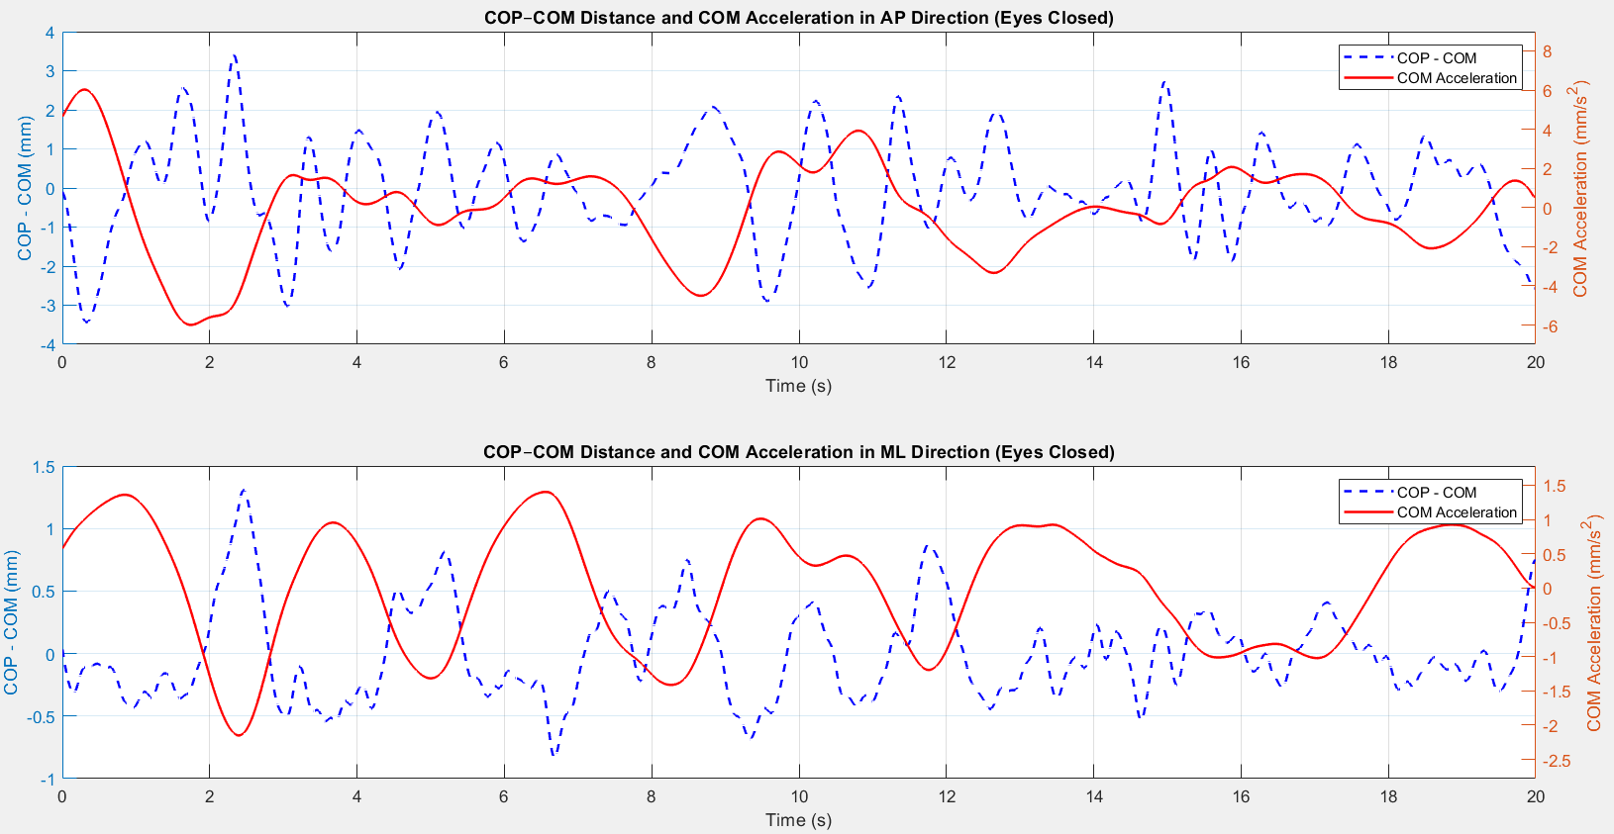
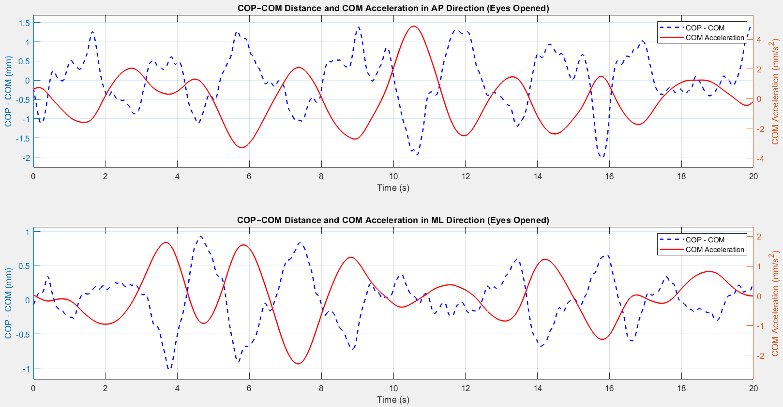
Figure 1-13 Figure1-14
This final pair of plots highlights the dynamic relationship between body sway (COP–COM distance) and the corrective effort of the postural system (COM acceleration). With eyes open, the system maintains stability through small, efficient corrections — seen in the close tracking between COP and COM and relatively smooth acceleration curves.
However, when the eyes are closed, instability increases, especially in the anterior-posterior direction, as seen by larger COP–COM mismatches, sharper COM acceleration peaks and more irregular correction responses.
These shifts reflect greater reliance on proprioceptive feedback and less efficient motor control.

Slide 23
Interpretation and Implications
The results indicate that visual input plays a critical role in maintaining postural stability, as evidenced by the increased sway metrics in the EC condition. The larger Romberg ratios for AP-related parameters suggest that the AP direction is more sensitive to the loss of visual feedback, likely due to the biomechanical constraints of the ankle strategy, which primarily controls AP sway. The relatively smaller changes in ML parameters may reflect the body’s reliance on hip strategy or vestibular/proprioceptive inputs for lateral stability.
The increased frequency and power in the EC condition indicate that the neuromuscular system compensates for the lack of vision by increasing the frequency and energy of corrective movements. This is consistent with the literature on postural control, where vision is known to reduce sway by providing a stable reference frame for spatial orientation (Prieto et al., 1996).
Conclusion
The static posture analysis using the Prieto algorithm demonstrates that removing visual input significantly increases postural sway, particularly in the AP direction, as reflected in larger excursions, velocities, sway areas, and frequency components. These findings underscore the importance of vision in balance control and provide a quantitative basis for assessing postural stability in clinical or research settings.

Slide 24
The use of a double platform setup in static posturography provides a deeper and more accurate insight into postural control mechanisms. Unlike the single-platform approach, which calculates a global COP from the combined force input of both feet, the double-platform system measures the COP under each foot individually (COPₗ and COPᵣ). These values are then integrated using a weighted average based on the corresponding vertical ground reaction forces (Rᵥₗ and Rᵥᵣ). This results in the net COP (COPₙₑₜ), which represents the body's actual sway behavior with higher sensitivity to asymmetries and limb-specific contributions.
This method is particularly valuable when analyzing bilateral coordination, weight distribution imbalances, and the dynamic contribution of each limb in maintaining upright posture. It enables the detection of subtle postural control deficits that might go unnoticed in single-platform measurements, especially in clinical populations (e.g., stroke, amputees) or during dual-task and perturbation testing.
Overall, the double-platform approach improves both the accuracy and interpretability of balance assessment, supporting more targeted interventions and individualized evaluations in both clinical and research settings.

Slide 25
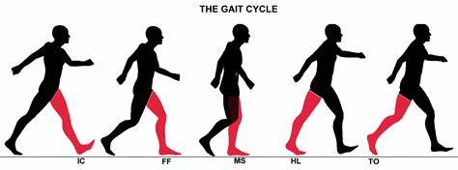
Gait analysis

Slide 26
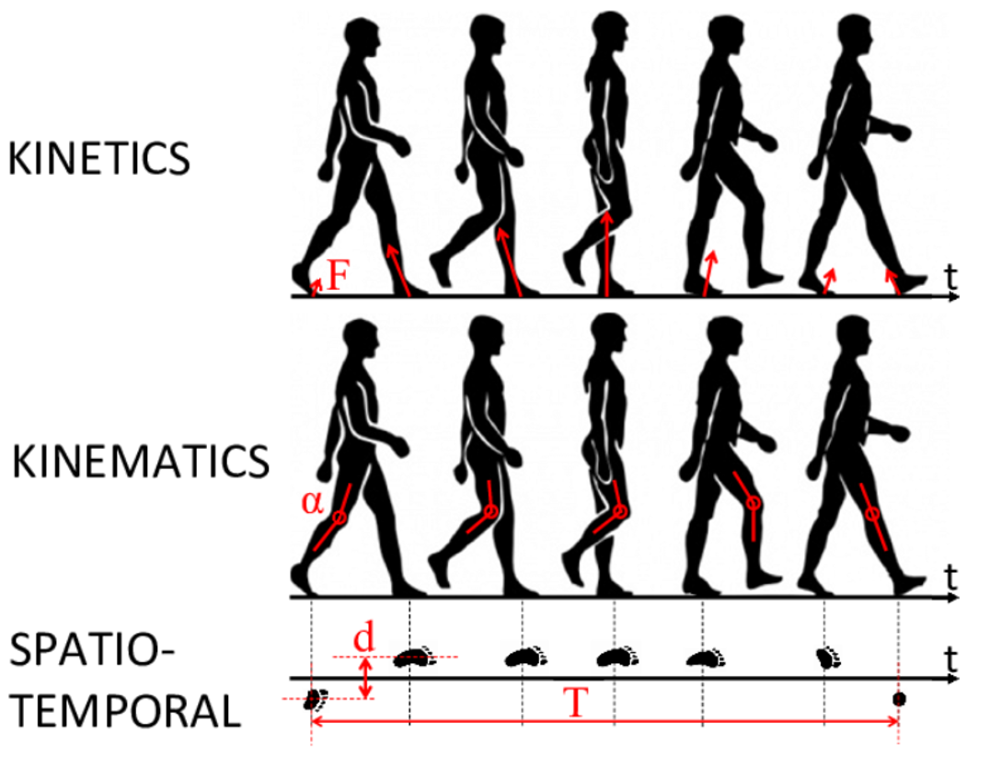

Introduction
Gait cycle is the study of human motion, focused on the way people walk or run. It is the systematic study of human locomotion using various tools and techniques to assess and quantify the movement patterns and mechanics of walking or running.
THE STANCE PHASE
(60%)
Foot is on the ground
Gait cycle (100%)
THE SWING PHASE
(40%)
The same foot of the previous phase is no longer in contact with the ground and the leg is swinging

Slide 27
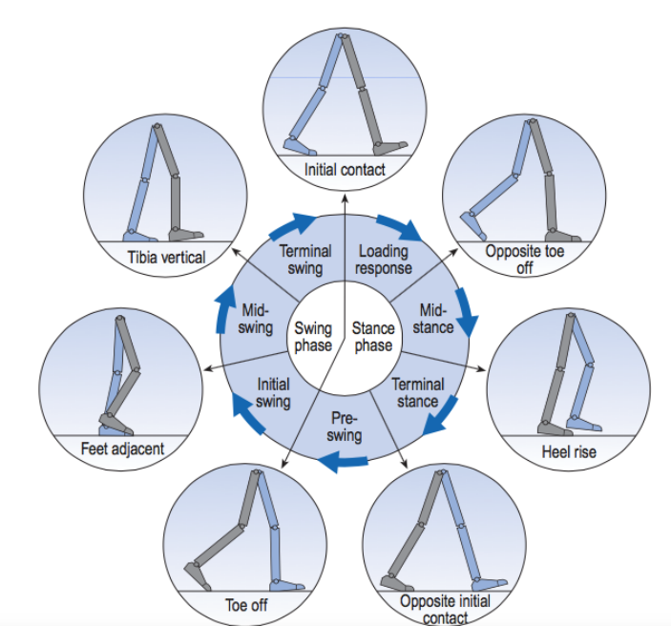
Introduction
In general, we can choose any one of these seven events in the figure and define the gait cycle, as it starts for instance from the begining of ‘inital contact’ of the right foot until the right foot touches the ground again
Every term of this cycle has its different physical anatomical characteristics which we will analyze it during the expermint.
Figure 1: Positions of the legs during a single gait cycle by the right leg.

Slide 28
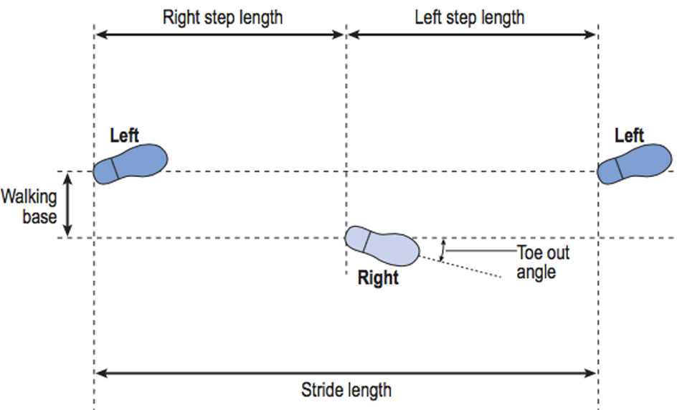
Introduction
In normal gait there is a natural symmetry between the left and right sides, but in pathological gait an asymmetrical pattern very often exists.
With normal subjects, the two step lengths will be approximately equal, but with certain patients (such as those with pathological gait), there will be an asymmetry between the left and right sides.

Slide 29
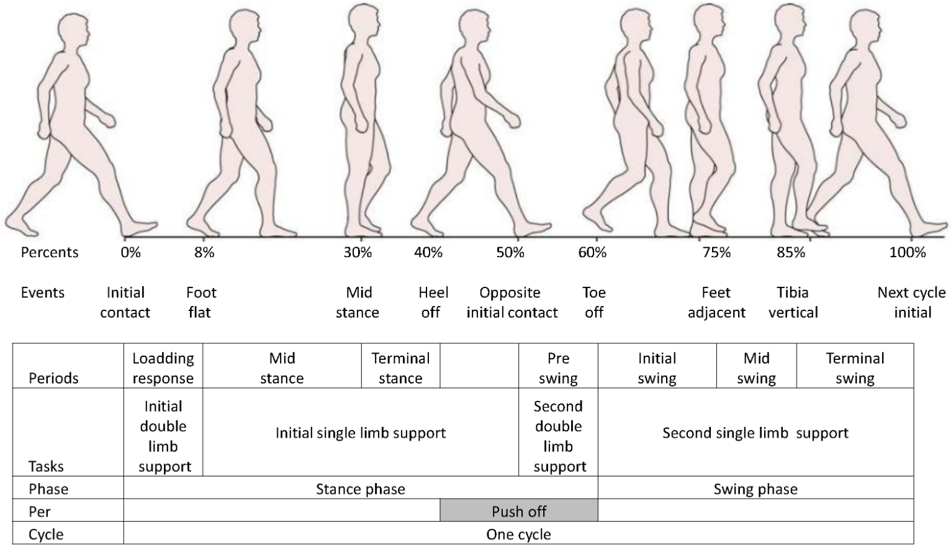
Introduction
Phase | Time in Cycle | Main Events
Stance | 0% – 60% | 1-Initial Contact 2-Foot Flat 3-Mid Stance 4-Heel Off 5-Opposite Initial Contact 6-Toe Off
Swing | 60% – 100% | 1-Toe Off 2-Feet Adjacent 3-Tibia Vertical 4-Next Cycle Initial Contact
The stance phase lasts from initial contact to toe off. It is subdivided into: Loading response, Mid-stance, Terminal stance, Pre-swing. The swing phase lasts from toe off to the next initial contact. It is subdivided into: Initial swing, Mid-swing, Terminal swing.
The duration of a complete gait cycle is known as the cycle time, which is divided into stance time and swing time.

Slide 30
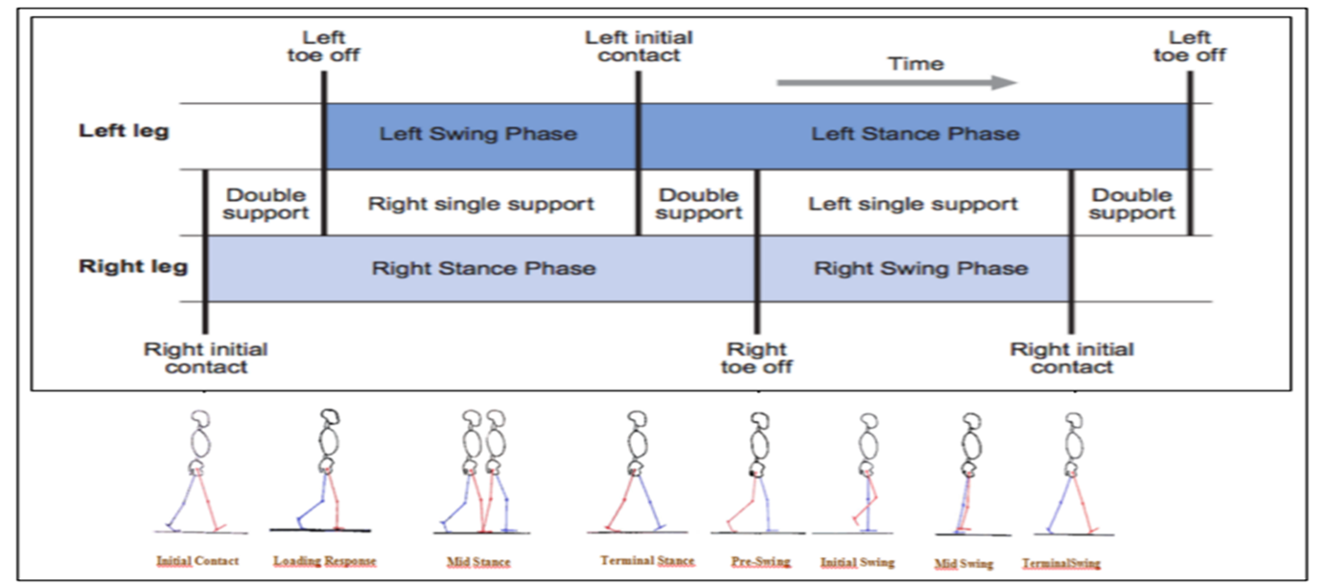
Introduction
Important terminologies
Single support
Double support
is the period of time when only one foot is in contact with the ground, which is equal to the swing phase of the other limb.
which also known as double limb stance is the period of time when both feet are in contact with the ground. This occurs twice in the gait cycle, at the beginning and end of the stance phase. In each double support phase, one foot is forward (known as leading leg), having just landed on the ground, and the other one is backward (known as trailing leg), being just about to leave the ground.

Slide 31
Introduction
Important terminologies
stride length
walking base
is the distance between two successive placements of the same foot.
(also known as the ‘stride width’ or ‘base of support’) is the side to-side distance between the line of the two feet

Slide 32
materials and methods
Main approach
A test was performed in the Movement Analysis Laboratory of Università Politecnica delle Marche,
on a young and healthy male subject whose weight was 74 kg according to this plan:
Subject videotaping prior to examination
Patient physical evaluation and measurement
Marker placement
Static offset measurement
Motion test
Electromyographic (EMG) assesment.

Slide 33
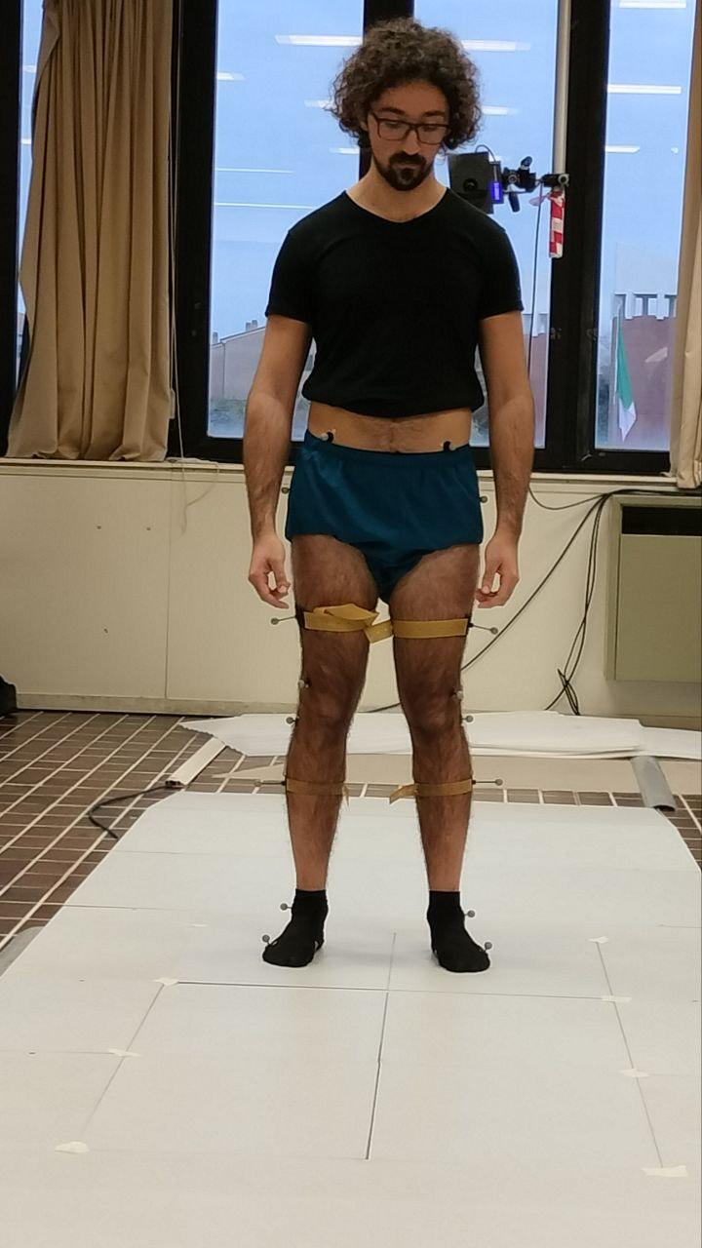
Materials and methods
Vaughan protocol
The Vaughan Protocol is a structured method for gait analysis that provides a standardized approach to measuring and interpreting human walking patterns. This protocol is widely used in biomechanics and physical therapy to analyze gait using kinematic, kinetic, and electromyographic (EMG) data.

Slide 34
materials and methods
Vaughan protocol
Vaughan protocol(Helen hayes) is following this stages:
anthropometric parameters aquisation
Marker placement
Three steps strategy
Determination of segment orientations
Angular knematics
Measurmentd of GRF(ground rection forces)
Calculaton of joint forces and moments

Slide 35
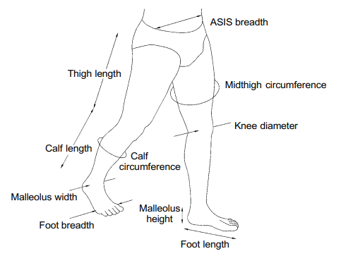
materials and methods
Vaughan protocol
The FIRST STEP for a proper gait analysis is the accurate estimation of the subject's body segment parameters.​​ We divide the lower body into four segments. These parameters, used in prediction equations, allows to characterize body segments. By the use of regression formulas, it is possible the estimation of values such as: masses and moments of inertia.

Slide 36
materials and methods
Vaughan protocol
ANTHROPOMETRIC PARAMETER | VALUE
Body Mass | 74 kg
ASIS breadth | 22.5 cm
thigh circumference | 53cm
Thigh length | 45 cm
Calf length | 39cm
Calf Circumference | 37 cm
Knee diameter | 7 cm
Foot length | 28 cm
malleolus width | 8 cm
malleolus height | 7 cm
foot breadth | 9 cm
After obtaining theses measurment(in the table),we apply those following formulas to measure segment mass and the moment of inertia: -Segment mass = C1(Total body mass) + C2 (Length)3 + C3. (where C1, C2, and C3 are regression coefficients.) -Segment moment of inertia = C4(Total body mass)*(Length)2 + C5. (where C4 and C5 are regression coefficients.)
Vaughan protocol

Slide 37
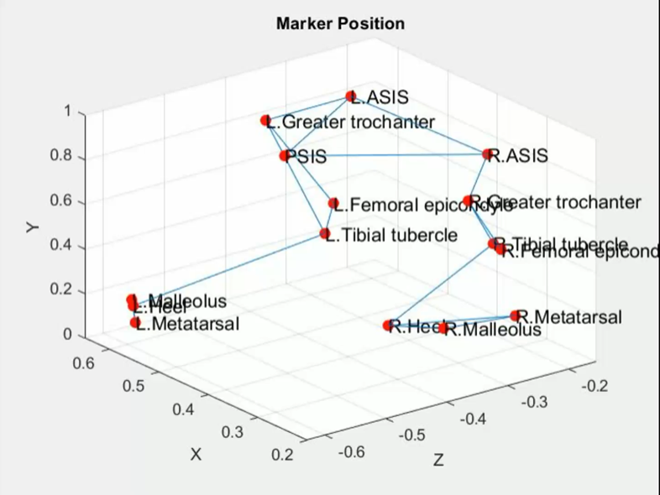
materials and methods
Vaughan protocol
The second step is marker position. For Vaughan protocol: all the position data have been found following a system of 15 external different markers referred to the laboratory reference frame during the gait trial.

Slide 38
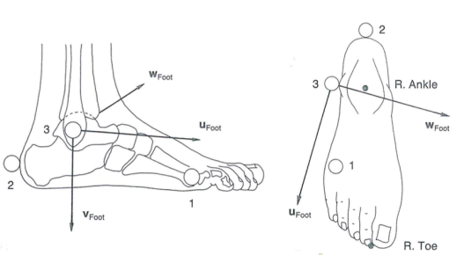
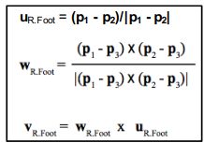
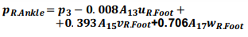
materials and methods
Vaughan protocol
The third step is the three steps strategy. We will follow these steps:
1. Select THREE MARKERS for each segment of interest;
2. Create an HORTOGONAL uvw REFERENCE SYSTEM based on the three markers;
3. Use prediction equations based on anthropometric measurements and the uvw reference system to estimate the joint centre positions.

Slide 39
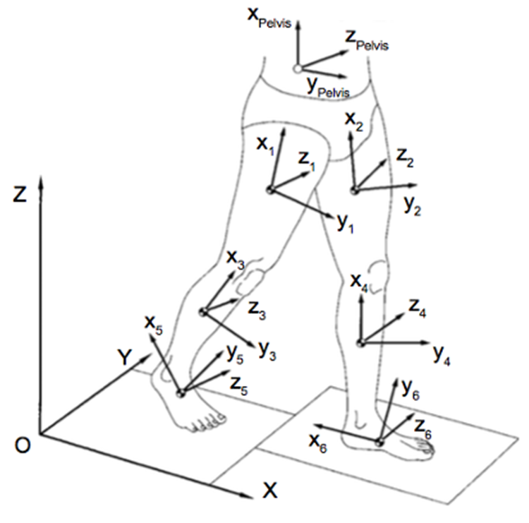
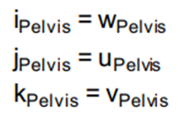
materials and methods
Vaughan protocol
The fourth step is Determination of segment orientations: We obtain the orientation of each segment in 3D space.
Embedding a reference system (xyz) in each segment which define the position relative to the global coordinate system (XYZ).
The origin of the anatomical coordinate system xyz is on the segment’s center of gravity.
IJK unit vectors in XYZ directions
ijk unit vectors in xyz directions

Slide 40
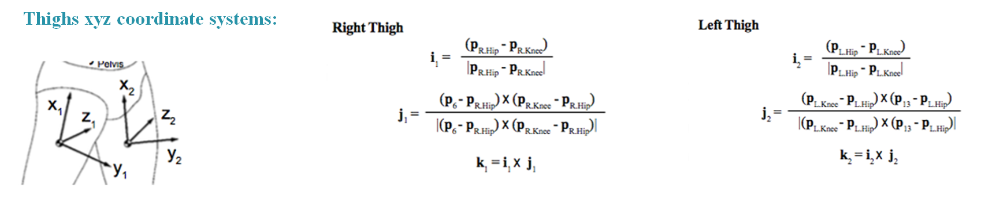
materials and methods
Vaughan protocol
An example of obtaining the results for right thigh-left thigh:
We will follow this appoach as well for: Right calf-Left calf -Right foot-Left foot

Slide 41
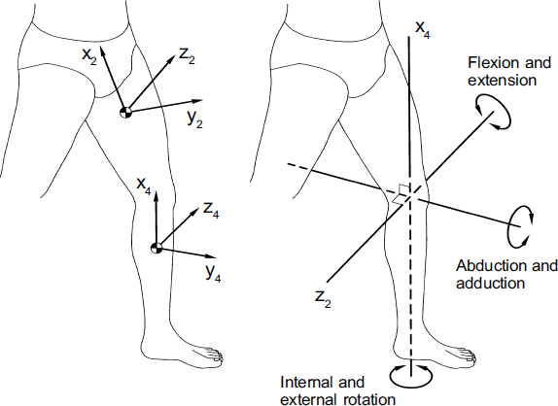
materials and methods
Vaughan protocol
The fifth step is determining Anatomical Joint Angles.
The Grood and Suntay convention is used.
Each joint has a reference frame in the proximal and distal segments.
Joint angles are defined as rotations of the distal segment relative to the proximal segment.
The rotations were be defined as:
Flexion/extension, taking place about the mediolateral axis of the proximal segment;
Internal/ external rotation, taking place about the longitudinal axis of the distal segment;
Abduction/adduction, taking place about a floating axis that is at right angles to both the flexion/extension and internal/external rotation axes.
This figure shows the Axis of rotation for the left knee. The proximal and distal reference frames are shown on the left, while the axes are highlighted on the right.

Slide 42
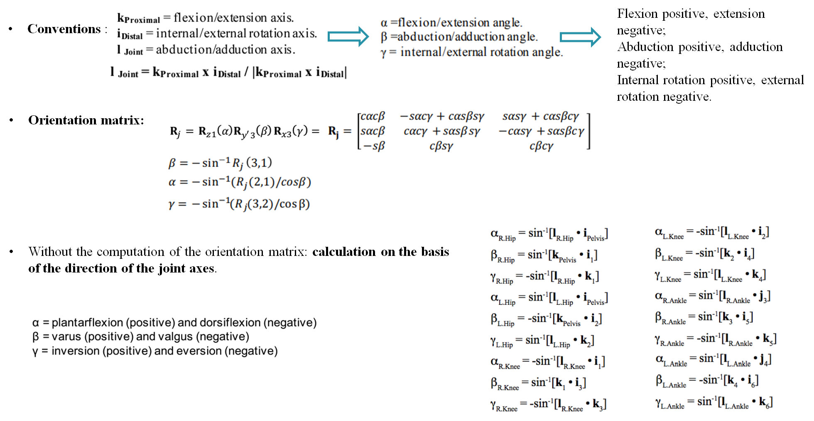
materials and methods
Vaughan protocol
JOINT | DISTAL | PROXIMAL
HIP | THIGH | PELVIS
KNEE | CALF | THIGH
ANKLE | FOOT | CALF
This table shows the distal and proximal reference for every segment.
The laws and equations to detrmine the angles.

Slide 43
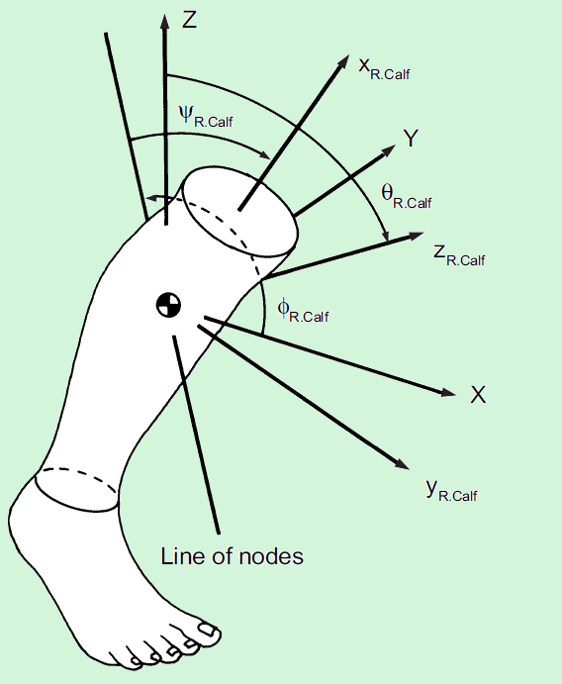
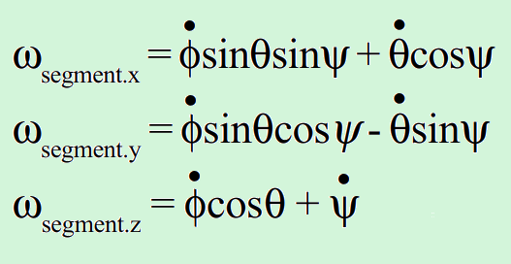
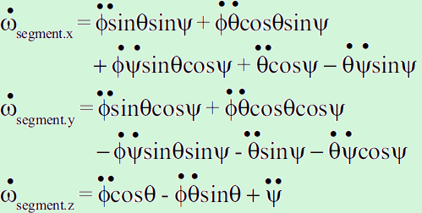
materials and methods
Vaughan protocol
Segment angular velocities were obtained from the Euler angles as follows :
Segment angular accelerations were obtained from the angular velocity as follows:
The three angular degrees of freedom (or Euler angles φ-R.Calf, θ-R.Calf, and ψ-R.Calf) define the orientation of the right Calf's reference axes (x-R.Calf, y-R.Calf, and z-R.Calf) relative to the global reference system XYZ.

Slide 44
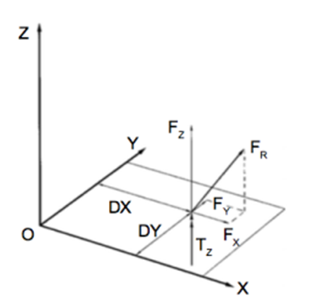
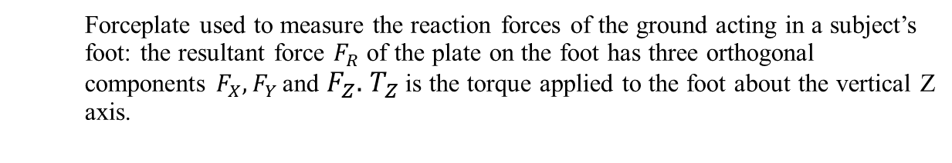
materials and methods
Vaughan protocol
The sixth step is the Measurements of GRF.

Slide 45
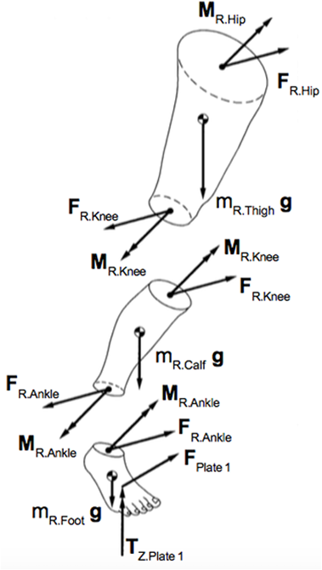
materials and methods
Vaughan protocol
The seventh and final step is Calculation of joint forces and moments:
.
Once known the body segment kinematics and the measures of the GRF it is possible to calculate the resultant forces and moments acting at the joints of the subject’s ankles, knees and hips.
First we will use Free Body Diagram for every segment of interest we will remove it from its environment. Starting from the foot segment external forces and moments acting on it are draw.

Slide 46
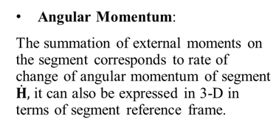
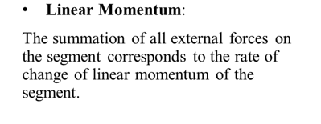
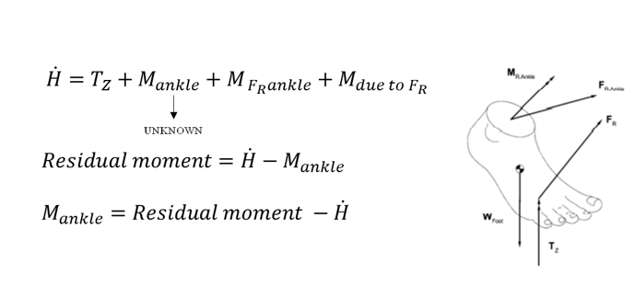
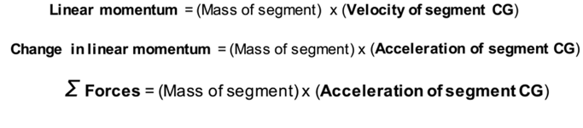
materials and methods
Vaughan protocol
This process is divided into two parts:
First:
Second:

Slide 47
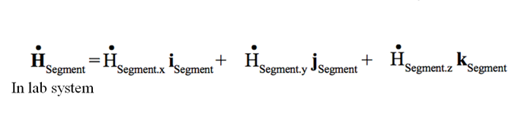
materials and methods
Vaughan protocol
Because the format for the time rate of change of angular momentum is similar for all segments, angular momentum H and its first derivative H’̇ can be expressed in 3-D in terms of the segment:

Slide 48
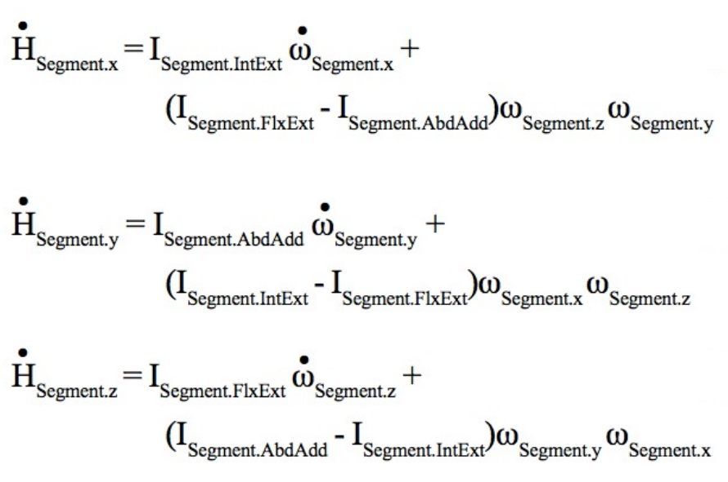
materials and methods
Vaughan protocol
The xyz components can be expressed in terms of moments of inertia, angular velocities, and angular accelerations (Goldstein, 1965) and due to Euler:

Slide 49

materials and methods
Vaughan protocol
An example of calculating the dynamics for right foot:

Slide 50

materials and methods
Vaughan protocol
Motion test:
Data from a minimum of two barefoot walks (with at least one full left and right gait cycle) are collected if only a kinematic assessment is to be performed, with three trials if a kinetic assessment is desired.
Acquisition frequency for kinematics: 250 Hz.
For each time instant of the motion test each anatomical reference marker system has been related to the coordinate of the global reference system.
Then, the data was filtered by means of a 4th order Butterworth low-pass filter with cut off frequency of 9 Hz.
Acquisition frequency for dynamics (Ground Reaction Forces (GRF) and Center of Pressure (COP) coordinates):
Both types of data have been used to find joint angles time evolution, internal joint powers and moments, and ground reaction forces time evolution in the three directions of space

Slide 51
Results and discussion
Vaughan protocol
Gait cycle events for the Helen Hayes protocol
Trial number |  | Initial contact Event (s) | Toe off Event (s) | Initial contact Event (s)
Average Gait | Left | 8.1 | 8.6 | 8.9
 | Right | 8.6 | 9.0 | 9.4
Starting from the acquisition, the left leg gait cycle was chosen based on two successive intial contact events: the first one occurred at 8.1 sec from the beginning of the trial, while the second one happened at 8.9 sec, as visible in Fig. of the next slide where the vertical component (displacement of the heels on Y-axis) of the left and right Heel marker is plotted. Stance and swing phases with their relative periods are also shown for the left Heel with the addition of the right Heel. We used the average of 4 gait cycles.

Slide 52

Results and discussion
Vaughan protocol
This graph is created to analyze the vertical height of heel markers for the right and left feet over time. By plotting the height in millimeters against time in seconds, to evaluate the lift and landing patterns of the heels, identifying key phases such as initial contact (IC) and toe-off (TO) to understand the vertical displacement dynamics during walking.
the vertical height of heel markers for the right (blue) and left (red) feet over a 12-second period. The right foot reaches peak heights of approximately 250–300 mm at regular intervals (e.g., 2 s, 4 s, 8 s), marking the swing phase, while the left foot follows a similar pattern with peaks offset (e.g., 1 s, 3 s, 7 s), reflecting alternating steps. Both feet drop to near 0 mm during stance phases, consistent with a typical gait cycle of about 1–1.5 s. The consistent peak heights and rhythmic alternation suggest a balanced gait, though slight variations in peak heights (e.g., left foot at 6–8 s)

Slide 53

Results and discussion
Vaughan protocol
This graph is created to analyze the height trajectories of the right and left feet throughout the gait cycle. By plotting the height in millimeters against the percentage of the gait cycle, aim to evaluate the vertical displacement and coordination of the feet, identifying key phases such as initial contact (IC), toe-off (TO), and other critical events to understand the lift and landing patterns during walking. The right foot (blue) reaches a peak height of approximately 250 mm around 20-30% of the cycle, followed by a second peak near 60-70%, reflecting the swing phase and step preparation. The left foot (red) peaks at around 250 mm (10-20%), with a secondary rise aligning with the right foot’s second peak, indicating coordinated movement. Both feet return to a low height at IC and TO, consistent with normal gait patterns
Figure 2: Gait cycle: stance (0-60%) and swing (60-100%) phase for the right leg.

Slide 54

Results and discussion
Vaughan protocol
Angular Kinematics - angles in the sagittal plane during gait cycle:
The hip flexes and extends once during the cycle.
The hip shows a range of almost 30° flexion to -10° extension, The limit of flexion is reached around the middle of the swing phase and the hip is then kept flexed until initial contact.
The peak extension is reached before the end of the stance phase, then the hip begins to flex again.
The knee angle starts around 0 degrees. It shows two flexion and two extension peaks during gait cycle. The knee is more or less fully extended before initial contact, and it flexes during the loading response and until the early part of the mid stance when it reaches its first flexion peak.
Figure 3: Sagittal plane joint angles – flexion (positve) and extension (negative)

Slide 55
Results and discussion
Vaughan protocol
This is the ‘stance phase knee flexion’ and it is a smooth factor, reducing force reaction that acts on foot and comes on upper segment.
Then it extends slightly through-out mid stance, and it starts flexing again reaching a peak during the initial swing. The second and highest flexion peak is the ‘swing phase knee flexion’ and that peak should be around 50° of flexion to avoid the tip of foot touching the ground. It extends rapidly until the next initial contact.
The ankle is usually in a neutral position at the initial contact.
After the IC, the ankle angle starts with plantarflexion, bringing the forefoot down into the ground. After reaching the first plantarflexion peak during loading response, it dorsiflexes since the tibia (during mid stance) moves forward over the foot and the ankle joint becomes dorsiflexed until the end of the terminal stance where the first dorsiflexion peak occurs.
immediately, the ankle again changes, It plantarflexes rapidly until the middle of the initial swing where it reaches the second plantarflexion peak and continues to dorsiflex until TV, where after the second dorsiflexion peak it comes back to the neutral position.

Slide 56

Results and discussion
Vaughan protocol
The graph illustrates the abduction-adduction angles of the hip, knee, and ankle during the gait cycle. The hip angle shows a slight abduction peak around 20-30% of the cycle, followed by adduction peak of around 9 ° towards toe-off (TO), indicating lateral stability during stance. The knee angle exhibits minimal variation (within ±2°), suggesting stable lateral alignment throughout the cycle. The ankle angle displays a small adduction peak of -30 ° near FA(around 70%), reflecting controlled lateral movement. These patterns indicate good lateral stability, consistent with normal gait mechanics, though the limited range of motion may suggest either high stability or potential data smoothing effects, warranting further investigation
Figure 4: Hip, Knee, and Ankle Abduction-Adduction Angles During Gait Cycle

Slide 57

Results and discussion
Vaughan protocol
The graph illustrates the external-internal rotation angles of the hip, knee, and ankle during the gait cycle. The hip angle shows a slight external rotation peak of approximately -4° around 20-30% of the cycle, followed by an internal rotation, and a return to external rotation (-2° to 0°) by initial contact (IC), indicating controlled rotational stability. The knee angle starts near 0° at IC, exhibits a gradual increase to a peak internal rotation of about 20° around 60-70% during swing, followed by a rapid external rotation to -20° by 80-90%, and returns to near 0° by IC. The ankle angle shows a slight internal rotation of 25° during early stance (10-20%), a sharp external rotation peak of -30° near toe-off (TO, 50-60%), and a recovery to 20-25° internal rotation by late swing (80-90%), returning to near 0° by IC, suggesting dynamic foot rotation. These patterns align with normal gait mechanics, with the hip showing moderate rotation, the knee displaying a pronounced swing-phase range (±20°), and the ankle reflecting pronation-supination cycles.
Figure 5: Hip, Knee, and Ankle External-Internal Rotation Angles During Gait Cycle

